Slide 1
Chapter 13

Slide 2
Objectives

Slide 3
Objectives (cont.)

Slide 4
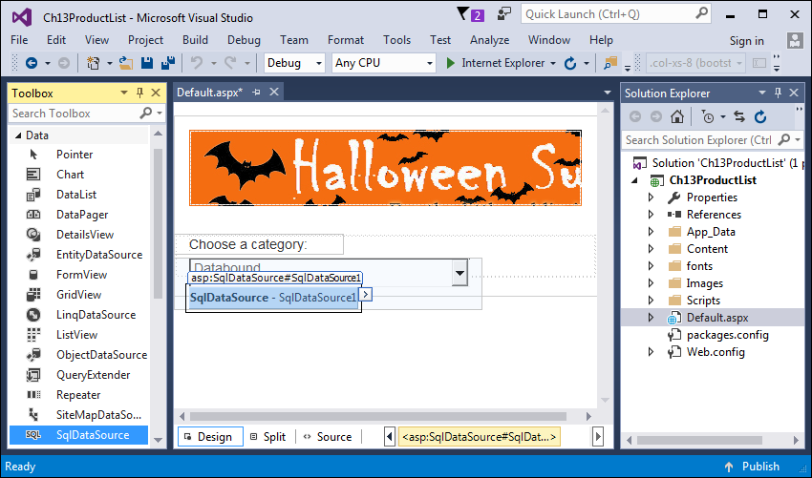
A SqlDataSource that’s bound to a drop-down list

Slide 5
The aspx code for the SqlDataSource control

Slide 6
Basic SqlDataSource control properties

Slide 7
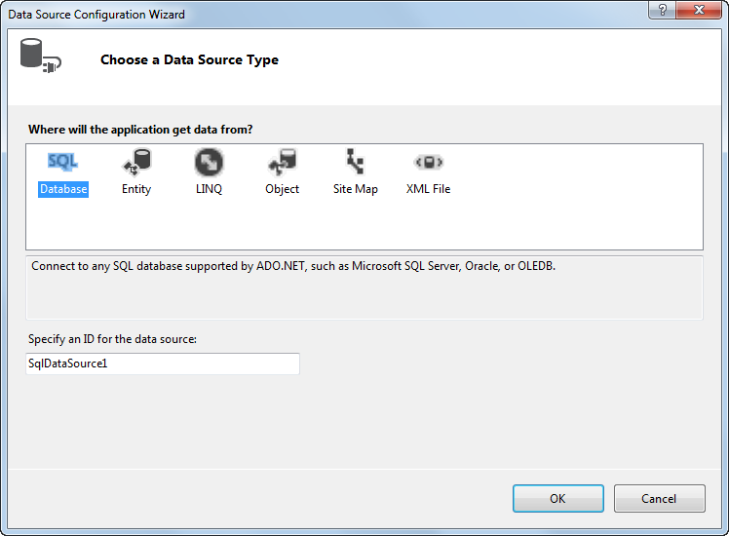
The dialog box for choosing a data source

Slide 8
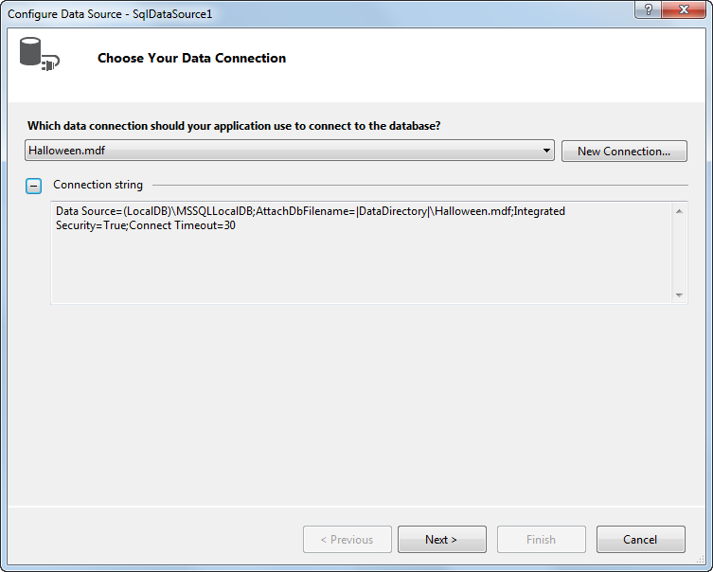
The dialog box for choosing a connection

Slide 9
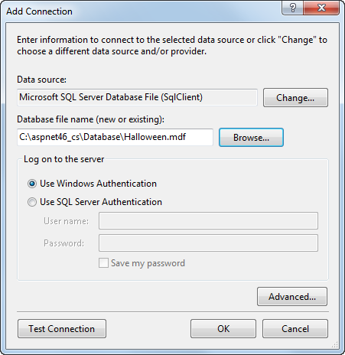
Defining a connection: The Add Connection box

Slide 10
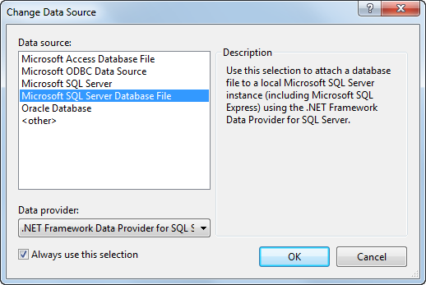
Defining a connection: The Change Data Source box

Slide 11
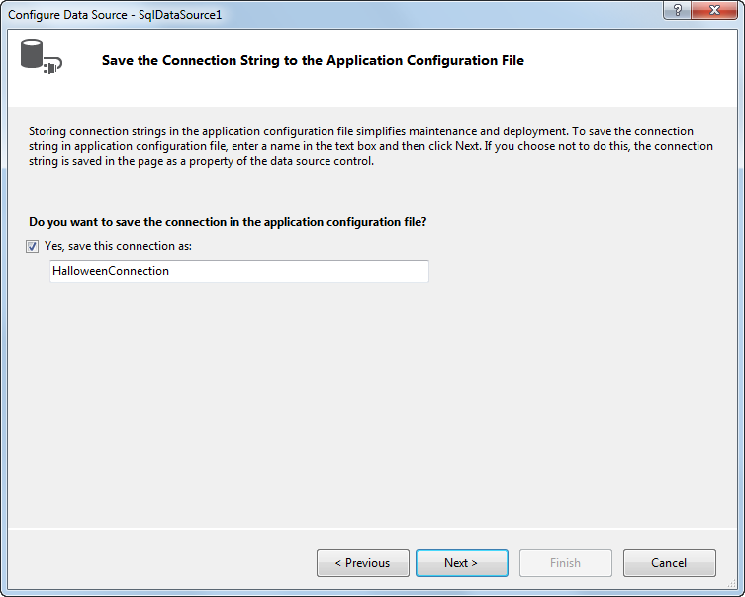
The dialog box for saving the connection string in the Web.config file

Slide 12
The ConnectionStrings section of the Web.config file
Aspx code that refers to a connection string in the Web.config file

Slide 13
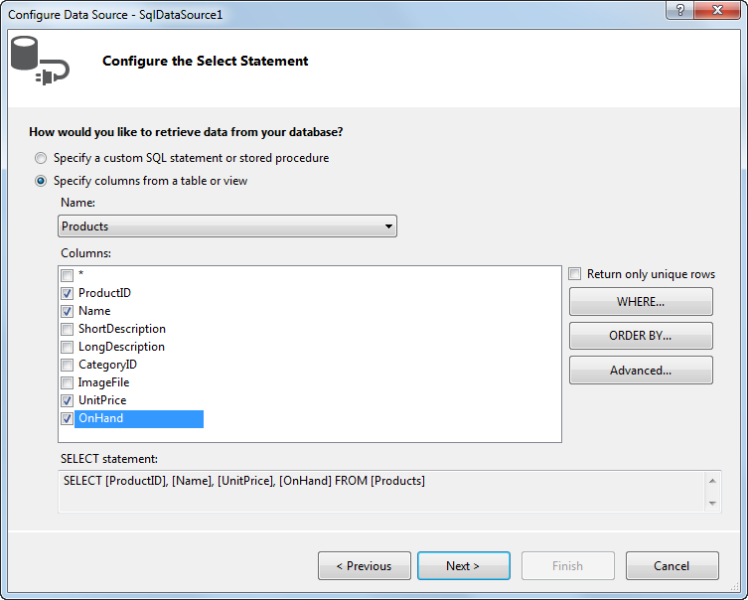
The dialog box for defining the SELECT statement

Slide 14
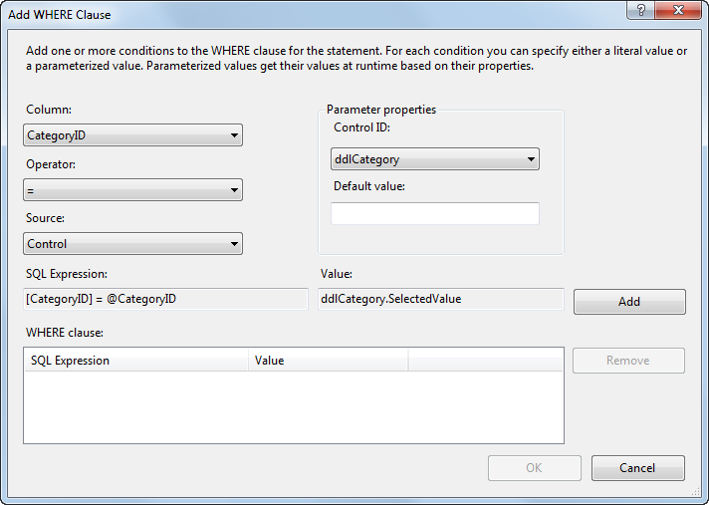
The Add WHERE Clause dialog box

Slide 15
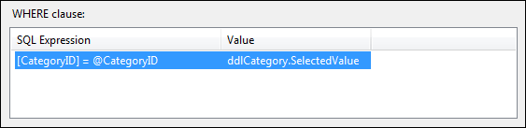
The WHERE clause section after a condition has been added

Slide 16
Elements used to define select parameters

Slide 17
Properties of the ControlParameter element

Slide 18
The aspx code for a SqlDataSource control that includes a select parameter

Slide 19
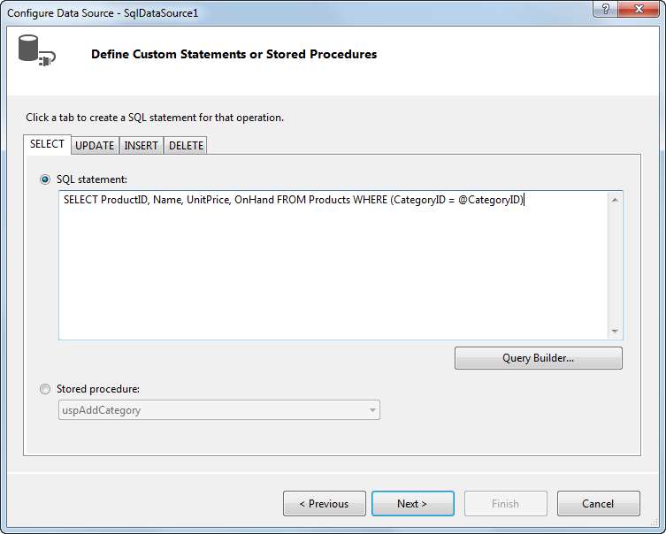
The dialog box for a custom SELECT statement

Slide 20
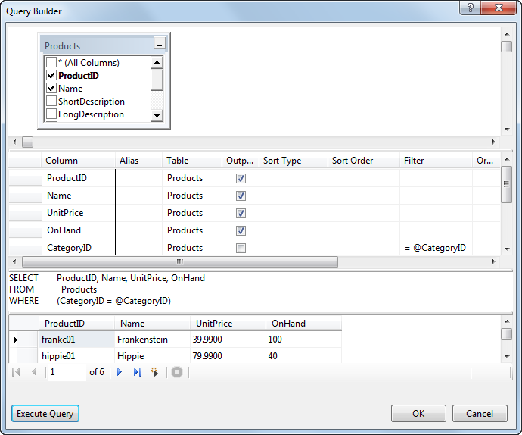
The Query Builder dialog box

Slide 21
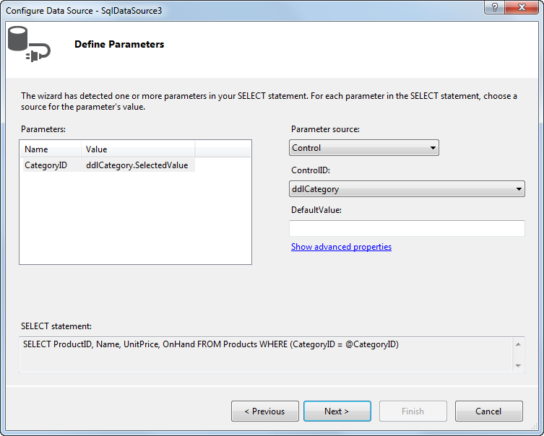
The dialog box for defining parameters

Slide 22
Parameter sources

Slide 23
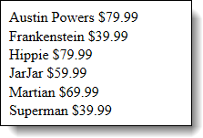
A simple list displayed by a DataList control
The aspx code for the DataList control

Slide 24
Basic properties of the DataList control

Slide 25
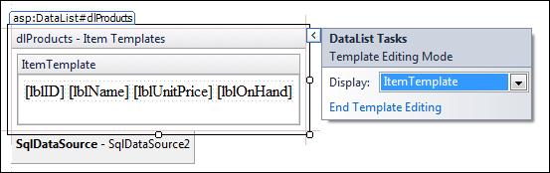
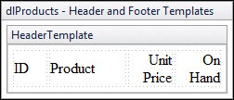
The Item template in template-editing mode
A Header template

Slide 26
Common template elements for a data list

Slide 27
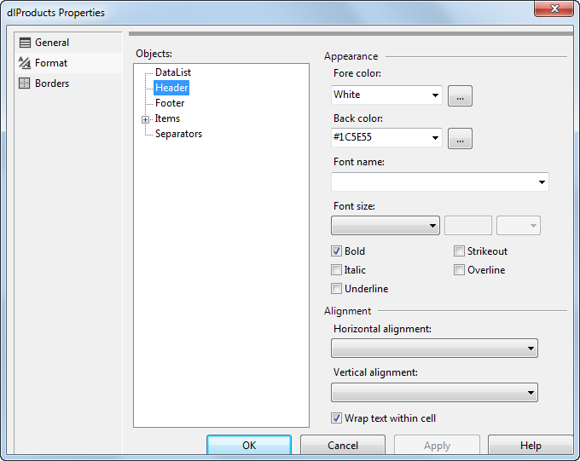
The Format page of the Properties dialog box

Slide 28
Common style elements for a data list
The asp tag for a Header style

Slide 29
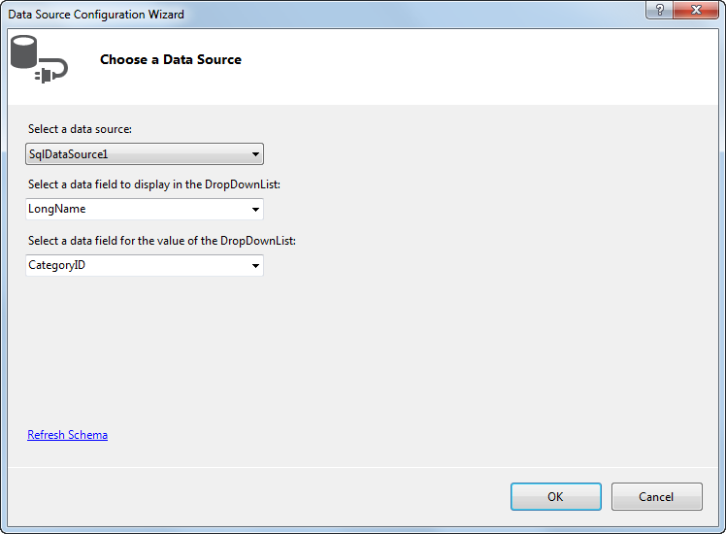
The Data Source Configuration Wizard for binding a drop-down list

Slide 30
List control properties for data binding
The aspx code for a drop-down list that’s bound to a SQL data source

Slide 31
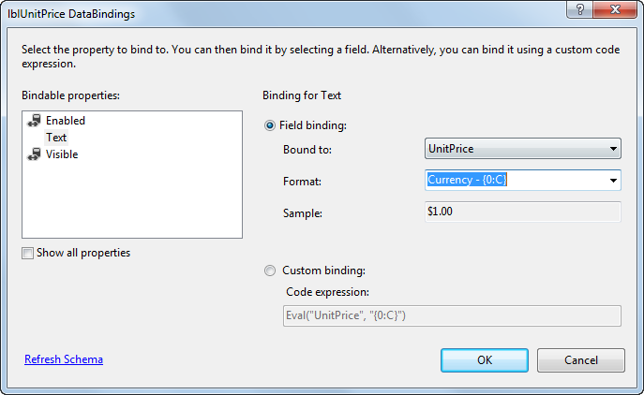
The DataBindings dialog box for binding a control

Slide 32
The syntax of the Eval and Bind methods
Code examples

Slide 33
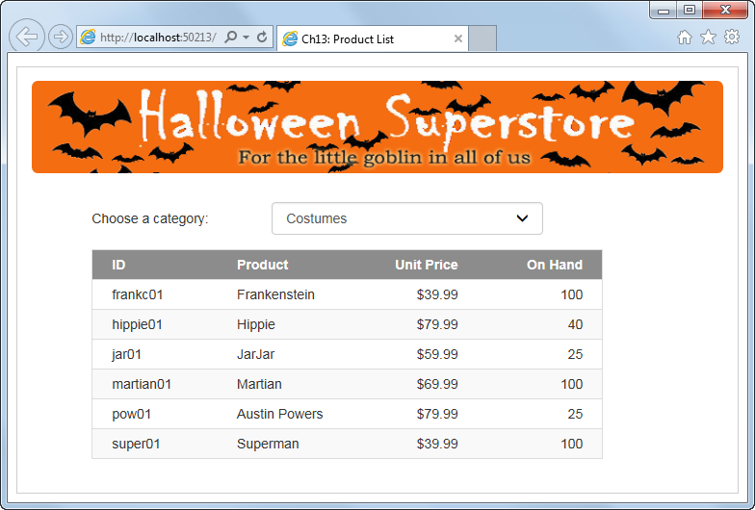
The Product List application

Slide 34
The Default.aspx file

Slide 35
The Default.aspx file (cont.)

Slide 36
The Default.aspx file (cont.)

Slide 37
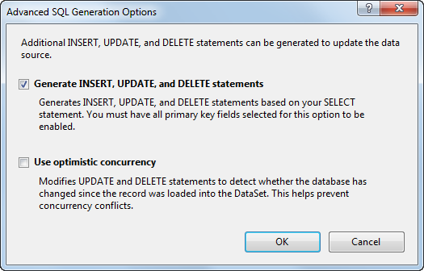
The Advanced SQL Generation Options dialog box

Slide 38
The aspx code for a SqlDataSource control that uses action queries

Slide 39
The aspx code for a SqlDataSource control that uses action queries (cont.)

Slide 40
A SqlDataSource control that uses a data reader

Slide 41
SqlDataSource properties for caching

Slide 42
A SqlDataSource control that uses caching

Slide 43
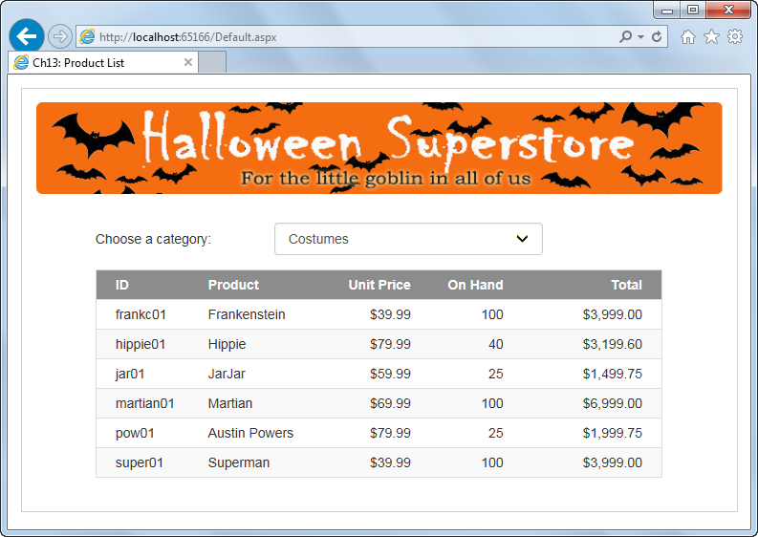
Extra 13-1 Enhance the Product List application

Slide 44
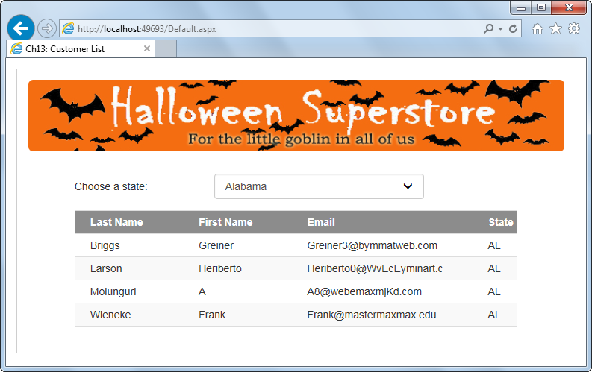
Extra 13-2 Create an application that displays customers by state

